Slide 1
Computer Vision Image Processing
Péter Molnár (January 2017)
Source: James Hayes http://www.cc.gatech.edu/~hays/compvision/

Slide 2
Programming Computer Vision with Python by Jan Erik Solem (PDF)
This is a good place to start working with images. The book and its examples mainly use
Python Imaging Library (PIL) www.pythonware.com/products/pil/ Handbook
Numpy http://www.numpy.org/
scikit-image http://scikit-image.org/
Web site http://programmingcomputervision.com/
Code repository: https://github.com/jesolem/PCV
Computer Vision: Algorithms and Applications by Richard Szeliski (PDF)
Comprehensive textbook on computer vision.
Web site http://szeliski.org/Book/

Slide 3
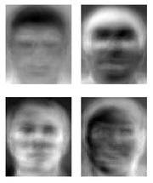
Ridiculously brief history of computer vision
1966: Minsky assigns computer vision as an undergrad summer project
1960’s: interpretation of synthetic worlds
1970’s: some progress on interpreting selected images
1980’s: ANNs come and go; shift toward geometry and increased mathematical rigor
1990’s: face recognition; statistical analysis in vogue
2000’s: broader recognition; large annotated datasets available; video processing starts
2010’s: Deep learning with ConvNets
2030’s: robot uprising?
Guzman ‘68
Ohta Kanade ‘78
Source: James Hayes http://www.cc.gatech.edu/~hays/compvision/
Turk and Pentland ‘91

Slide 4
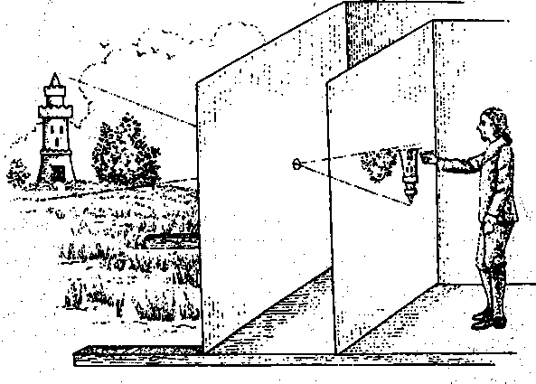
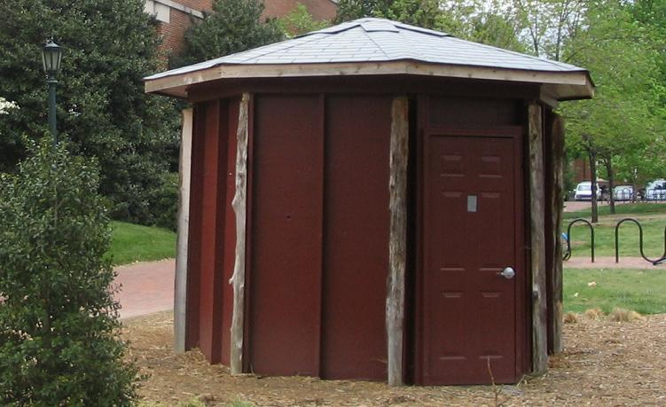
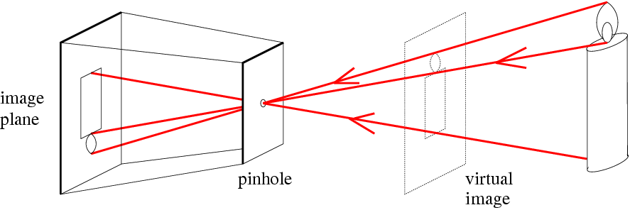
f
c
Illustration of Camera Obscura
Freestanding camera obscura at UNC Chapel Hill
Photo by Seth Ilys
f = focal length
c = center of the camera
Figure from Forsyth

Slide 5
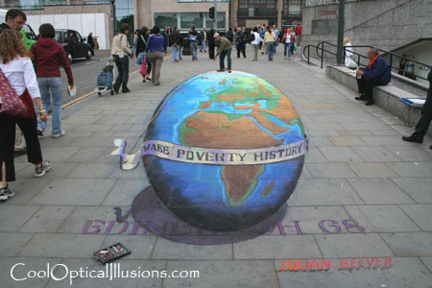
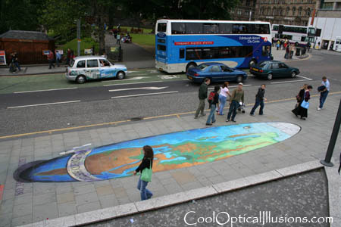
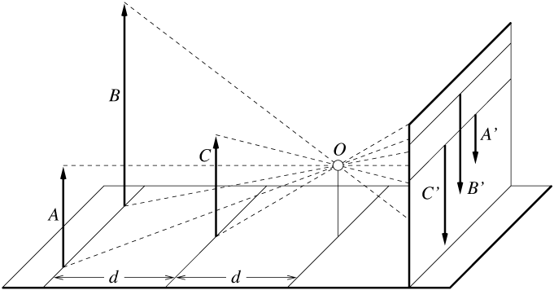
Projective Geometry:
length and area are not preserved
Figure by David Forsyth

Slide 6
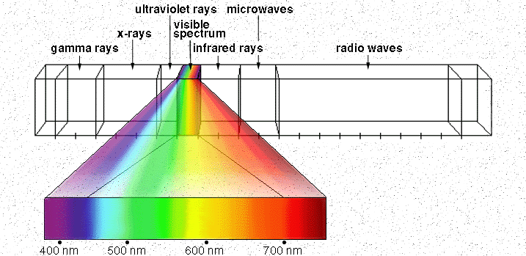
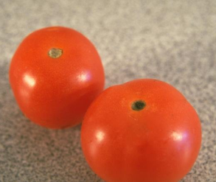
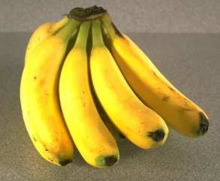
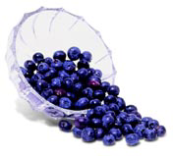
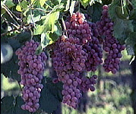
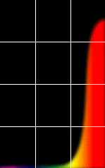
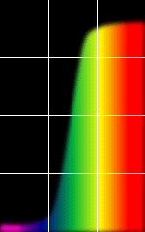
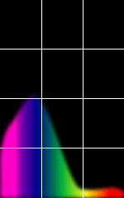
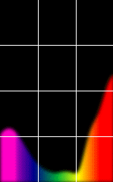
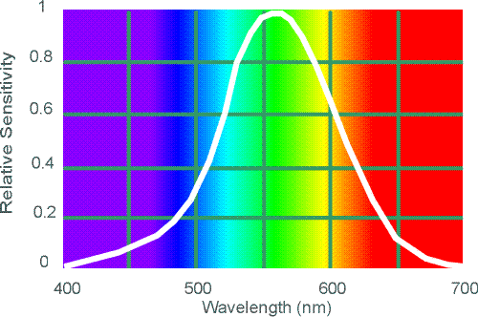
http://www.yorku.ca/eye/photopik.htm
Red
Yellow
Blue
Purple
% Photons Reflected
Wavelength (nm)

Slide 7
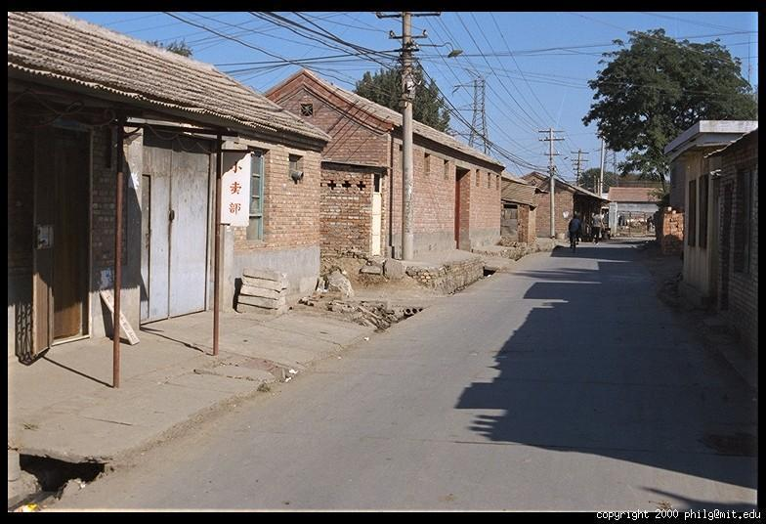
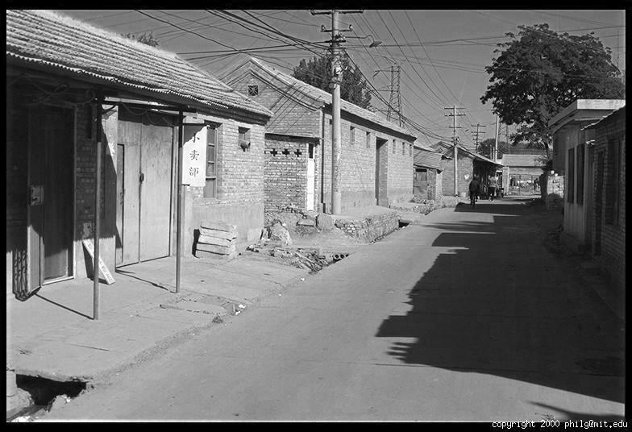
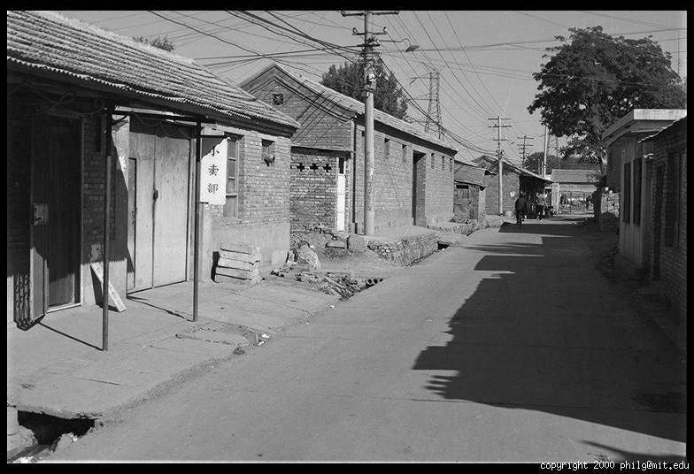
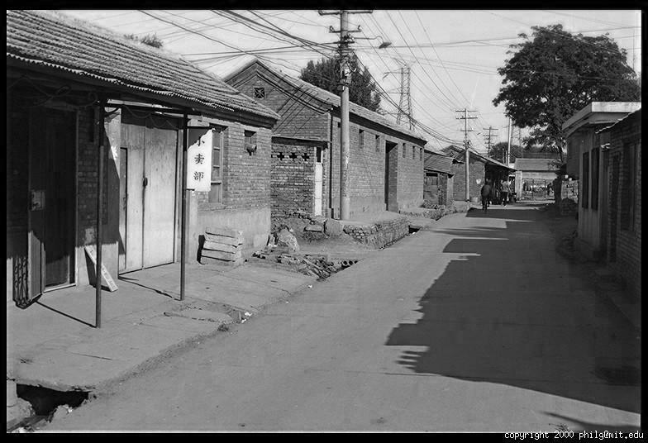
Images represented as a matrix
Suppose we have a NxM RGB image called “im”
im(1,1,1) = top-left pixel value in R-channel
im(y, x, b) = y pixels down, x pixels to right in the b^{th} channel
im(N, M, 3) = bottom-right pixel in B-channel
imread(filename) returns a uint8 image (values 0 to 255)
Convert to double format (values 0 to 1) with im2double
Red
column
row
0.92 | 0.93 | 0.94 | 0.97 | 0.62 | 0.37 | 0.85 | 0.97 | 0.93 | 0.92 | 0.99
0.95 | 0.89 | 0.82 | 0.89 | 0.56 | 0.31 | 0.75 | 0.92 | 0.81 | 0.95 | 0.91
0.89 | 0.72 | 0.51 | 0.55 | 0.51 | 0.42 | 0.57 | 0.41 | 0.49 | 0.91 | 0.92
0.96 | 0.95 | 0.88 | 0.94 | 0.56 | 0.46 | 0.91 | 0.87 | 0.90 | 0.97 | 0.95
0.71 | 0.81 | 0.81 | 0.87 | 0.57 | 0.37 | 0.80 | 0.88 | 0.89 | 0.79 | 0.85
0.49 | 0.62 | 0.60 | 0.58 | 0.50 | 0.60 | 0.58 | 0.50 | 0.61 | 0.45 | 0.33
0.86 | 0.84 | 0.74 | 0.58 | 0.51 | 0.39 | 0.73 | 0.92 | 0.91 | 0.49 | 0.74
0.96 | 0.67 | 0.54 | 0.85 | 0.48 | 0.37 | 0.88 | 0.90 | 0.94 | 0.82 | 0.93
0.69 | 0.49 | 0.56 | 0.66 | 0.43 | 0.42 | 0.77 | 0.73 | 0.71 | 0.90 | 0.99
0.79 | 0.73 | 0.90 | 0.67 | 0.33 | 0.61 | 0.69 | 0.79 | 0.73 | 0.93 | 0.97
0.91 | 0.94 | 0.89 | 0.49 | 0.41 | 0.78 | 0.78 | 0.77 | 0.89 | 0.99 | 0.93
R
G
Green
0.92 | 0.93 | 0.94 | 0.97 | 0.62 | 0.37 | 0.85 | 0.97 | 0.93 | 0.92 | 0.99
0.95 | 0.89 | 0.82 | 0.89 | 0.56 | 0.31 | 0.75 | 0.92 | 0.81 | 0.95 | 0.91
0.89 | 0.72 | 0.51 | 0.55 | 0.51 | 0.42 | 0.57 | 0.41 | 0.49 | 0.91 | 0.92
0.96 | 0.95 | 0.88 | 0.94 | 0.56 | 0.46 | 0.91 | 0.87 | 0.90 | 0.97 | 0.95
0.71 | 0.81 | 0.81 | 0.87 | 0.57 | 0.37 | 0.80 | 0.88 | 0.89 | 0.79 | 0.85
0.49 | 0.62 | 0.60 | 0.58 | 0.50 | 0.60 | 0.58 | 0.50 | 0.61 | 0.45 | 0.33
0.86 | 0.84 | 0.74 | 0.58 | 0.51 | 0.39 | 0.73 | 0.92 | 0.91 | 0.49 | 0.74
0.96 | 0.67 | 0.54 | 0.85 | 0.48 | 0.37 | 0.88 | 0.90 | 0.94 | 0.82 | 0.93
0.69 | 0.49 | 0.56 | 0.66 | 0.43 | 0.42 | 0.77 | 0.73 | 0.71 | 0.90 | 0.99
0.79 | 0.73 | 0.90 | 0.67 | 0.33 | 0.61 | 0.69 | 0.79 | 0.73 | 0.93 | 0.97
0.91 | 0.94 | 0.89 | 0.49 | 0.41 | 0.78 | 0.78 | 0.77 | 0.89 | 0.99 | 0.93
0.92 | 0.93 | 0.94 | 0.97 | 0.62 | 0.37 | 0.85 | 0.97 | 0.93 | 0.92 | 0.99
0.95 | 0.89 | 0.82 | 0.89 | 0.56 | 0.31 | 0.75 | 0.92 | 0.81 | 0.95 | 0.91
0.89 | 0.72 | 0.51 | 0.55 | 0.51 | 0.42 | 0.57 | 0.41 | 0.49 | 0.91 | 0.92
0.96 | 0.95 | 0.88 | 0.94 | 0.56 | 0.46 | 0.91 | 0.87 | 0.90 | 0.97 | 0.95
0.71 | 0.81 | 0.81 | 0.87 | 0.57 | 0.37 | 0.80 | 0.88 | 0.89 | 0.79 | 0.85
0.49 | 0.62 | 0.60 | 0.58 | 0.50 | 0.60 | 0.58 | 0.50 | 0.61 | 0.45 | 0.33
0.86 | 0.84 | 0.74 | 0.58 | 0.51 | 0.39 | 0.73 | 0.92 | 0.91 | 0.49 | 0.74
0.96 | 0.67 | 0.54 | 0.85 | 0.48 | 0.37 | 0.88 | 0.90 | 0.94 | 0.82 | 0.93
0.69 | 0.49 | 0.56 | 0.66 | 0.43 | 0.42 | 0.77 | 0.73 | 0.71 | 0.90 | 0.99
0.79 | 0.73 | 0.90 | 0.67 | 0.33 | 0.61 | 0.69 | 0.79 | 0.73 | 0.93 | 0.97
0.91 | 0.94 | 0.89 | 0.49 | 0.41 | 0.78 | 0.78 | 0.77 | 0.89 | 0.99 | 0.93
B
Blue

Slide 8
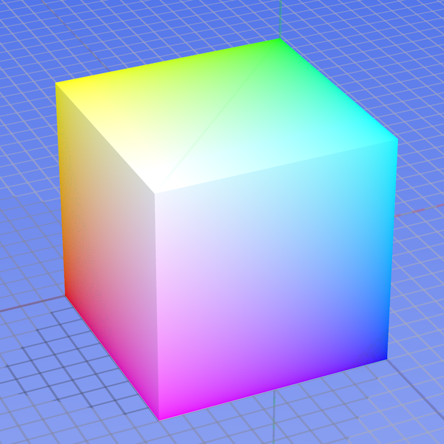
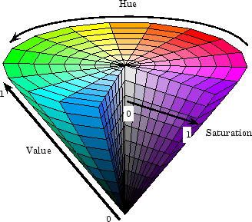



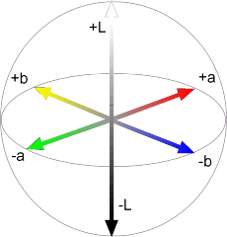
0,1,0
1,0,0
Y=0
Y=0.5
0,0,1
Cr
Y=1
Cb
Default: strongly correlated channels, non-perceptual
HSV: intuitive color space
YCbCr: fast to compute, good for compression, used by TV
L*a*b: perceptually uniform

Slide 9
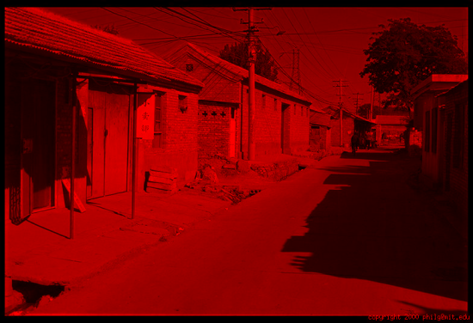
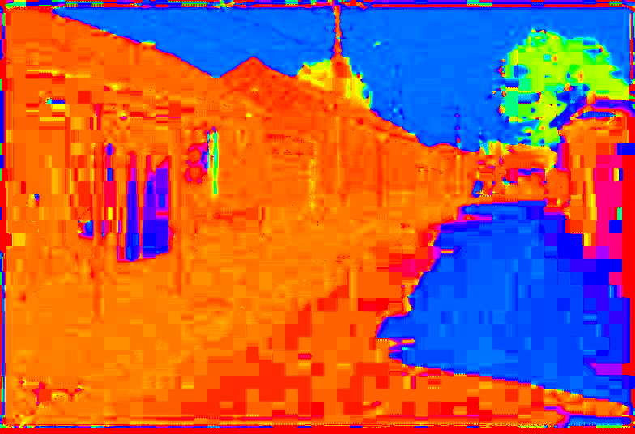
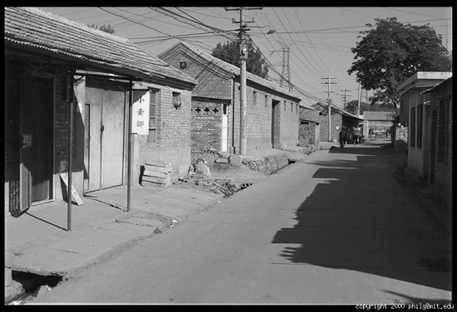
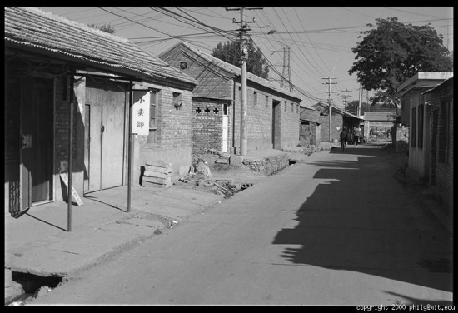
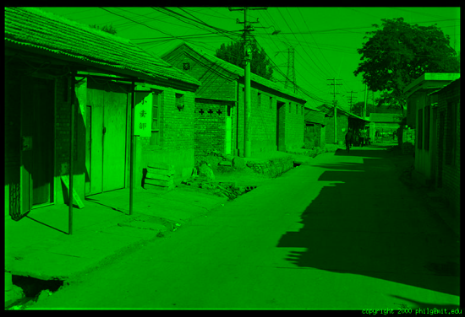
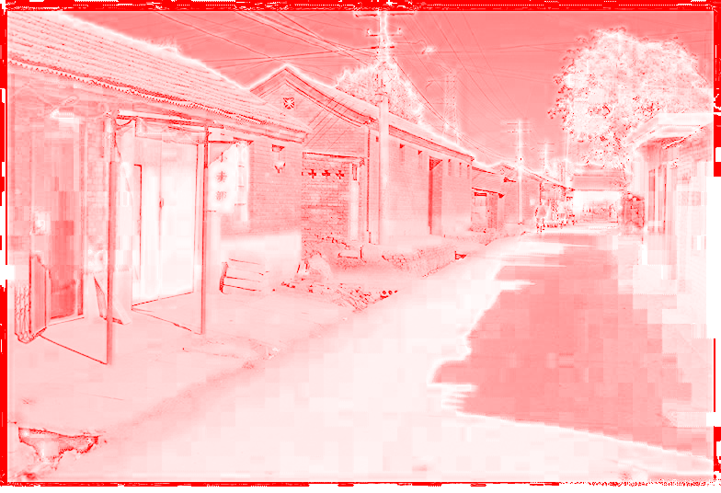

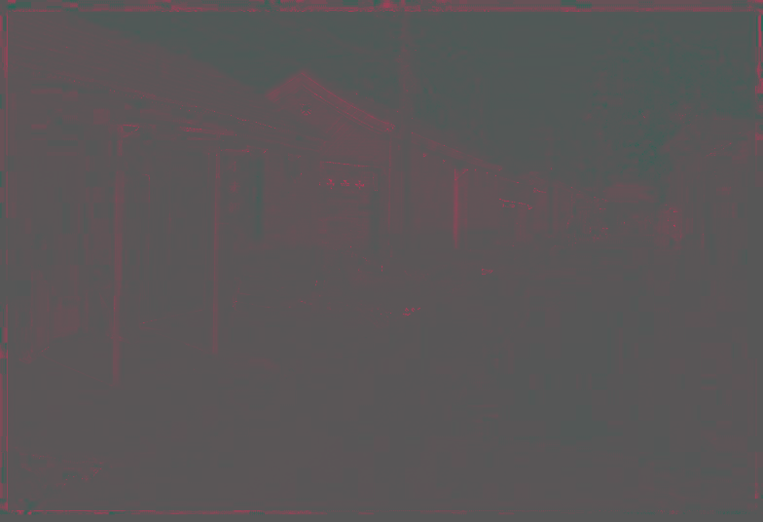
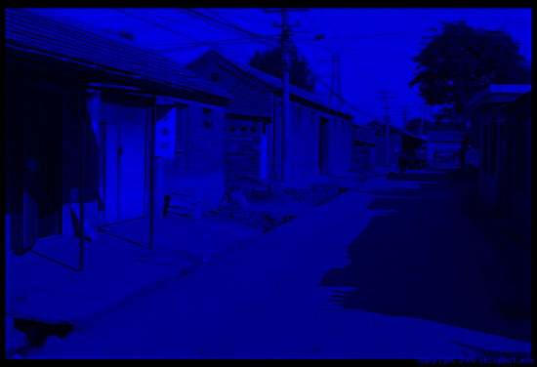
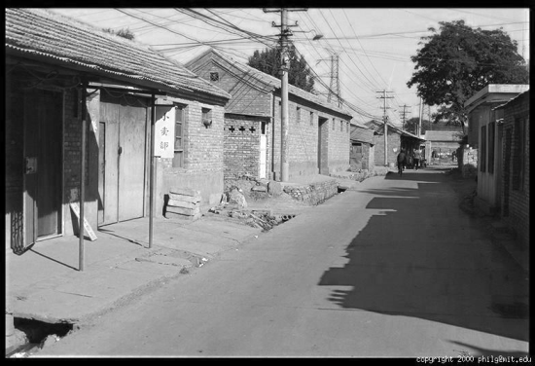


R (G=0,B=0)
H (S=1,V=1)
Y (Cb=0.5,Cr=0.5)
L (a=0,b=0)
G (R=0,B=0)
S (H=1,V=1)
Cb (Y=0.5,Cr=0.5)
a (L=65,b=0)
B (R=0,G=0)
V (H=1,S=0)
Cr (Y=0.5,Cb=05)
b (L=65,a=0)

Slide 10

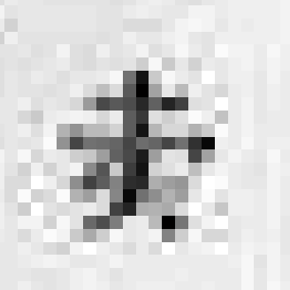
0.92 | 0.93 | 0.94 | 0.97 | 0.62 | 0.37 | 0.85 | 0.97 | 0.93 | 0.92 | 0.99
0.95 | 0.89 | 0.82 | 0.89 | 0.56 | 0.31 | 0.75 | 0.92 | 0.81 | 0.95 | 0.91
0.89 | 0.72 | 0.51 | 0.55 | 0.51 | 0.42 | 0.57 | 0.41 | 0.49 | 0.91 | 0.92
0.96 | 0.95 | 0.88 | 0.94 | 0.56 | 0.46 | 0.91 | 0.87 | 0.90 | 0.97 | 0.95
0.71 | 0.81 | 0.81 | 0.87 | 0.57 | 0.37 | 0.80 | 0.88 | 0.89 | 0.79 | 0.85
0.49 | 0.62 | 0.60 | 0.58 | 0.50 | 0.60 | 0.58 | 0.50 | 0.61 | 0.45 | 0.33
0.86 | 0.84 | 0.74 | 0.58 | 0.51 | 0.39 | 0.73 | 0.92 | 0.91 | 0.49 | 0.74
0.96 | 0.67 | 0.54 | 0.85 | 0.48 | 0.37 | 0.88 | 0.90 | 0.94 | 0.82 | 0.93
0.69 | 0.49 | 0.56 | 0.66 | 0.43 | 0.42 | 0.77 | 0.73 | 0.71 | 0.90 | 0.99
0.79 | 0.73 | 0.90 | 0.67 | 0.33 | 0.61 | 0.69 | 0.79 | 0.73 | 0.93 | 0.97
0.91 | 0.94 | 0.89 | 0.49 | 0.41 | 0.78 | 0.78 | 0.77 | 0.89 | 0.99 | 0.93

Slide 11

0 | 0 | 0 | 0 | 0 | 0 | 0 | 0 | 0 | 0
0 | 0 | 0 | 0 | 0 | 0 | 0 | 0 | 0 | 0
0 | 0 | 0 | 90 | 90 | 90 | 90 | 90 | 0 | 0
0 | 0 | 0 | 90 | 90 | 90 | 90 | 90 | 0 | 0
0 | 0 | 0 | 90 | 90 | 90 | 90 | 90 | 0 | 0
0 | 0 | 0 | 90 | 0 | 90 | 90 | 90 | 0 | 0
0 | 0 | 0 | 90 | 90 | 90 | 90 | 90 | 0 | 0
0 | 0 | 0 | 0 | 0 | 0 | 0 | 0 | 0 | 0
0 | 0 | 90 | 0 | 0 | 0 | 0 | 0 | 0 | 0
0 | 0 | 0 | 0 | 0 | 0 | 0 | 0 | 0 | 0
0 | 0 | 0 | 0 | 0 | 0 | 0 | 0 | 0 | 0
0 | 0 | 0 | 0 | 0 | 0 | 0 | 0 | 0 | 0
0 | 0 | 0 | 90 | 90 | 90 | 90 | 90 | 0 | 0
0 | 0 | 0 | 90 | 90 | 90 | 90 | 90 | 0 | 0
0 | 0 | 0 | 90 | 90 | 90 | 90 | 90 | 0 | 0
0 | 0 | 0 | 90 | 0 | 90 | 90 | 90 | 0 | 0
0 | 0 | 0 | 90 | 90 | 90 | 90 | 90 | 0 | 0
0 | 0 | 0 | 0 | 0 | 0 | 0 | 0 | 0 | 0
0 | 0 | 90 | 0 | 0 | 0 | 0 | 0 | 0 | 0
0 | 0 | 0 | 0 | 0 | 0 | 0 | 0 | 0 | 0
 | 0 | 10 | 20 | 30 | 30 | 30 | 20 | 10
 | 0 | 20 | 40 | 60 | 60 | 60 | 40 | 20
 | 0 | 30 | 60 | 90 | 90 | 90 | 60 | 30
 | 0 | 30 | 50 | 80 | 80 | 90 | 60 | 30
 | 0 | 30 | 50 | 80 | 80 | 90 | 60 | 30
 | 0 | 20 | 30 | 50 | 50 | 60 | 40 | 20
 | 10 | 20 | 30 | 30 | 30 | 30 | 20 | 10
 | 10 | 10 | 10 | 0 | 0 | 0 | 0 | 0
1
1
1
 | 0 | 10 | 20
1
1
1
1
1
1
Credit: S. Seitz

Slide 12
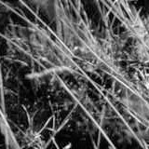
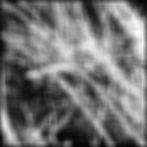
1
1
1
Box Filter
Replaces each pixel with an average of its neighborhood
Achieve smoothing effect (remove sharp features)
1
1
1
1
1
1

Slide 13
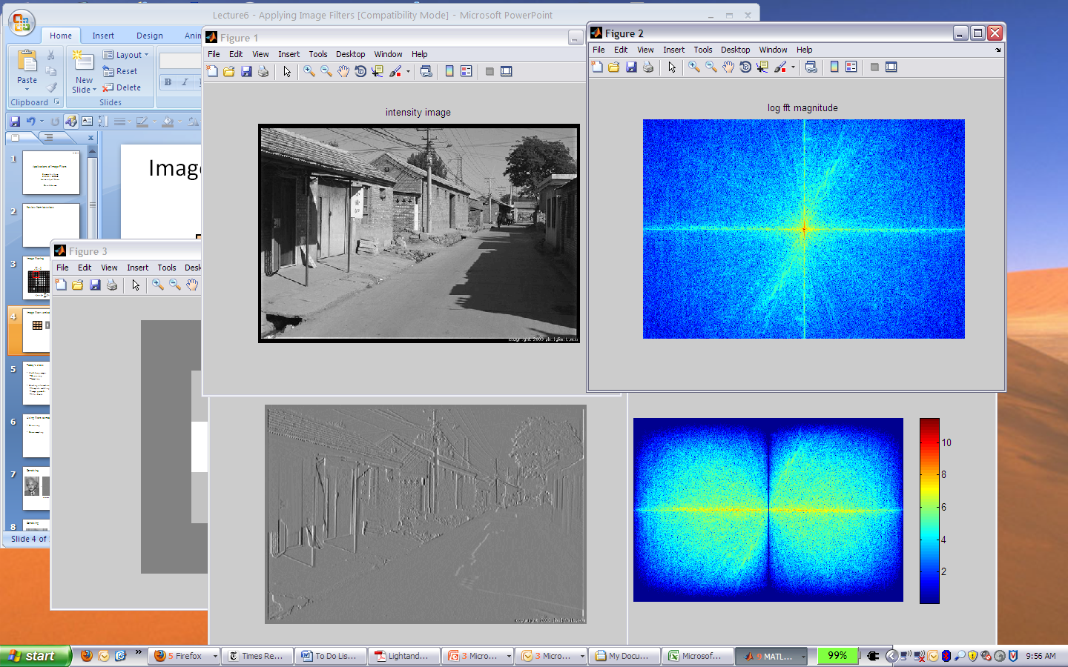
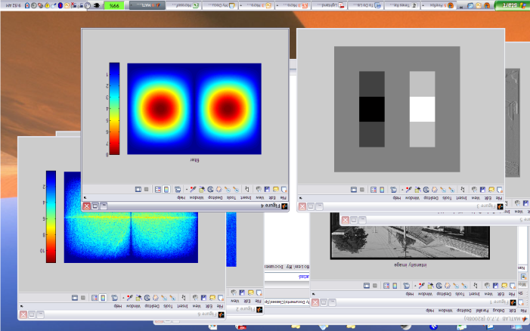
*
1
0
-1
=
2
0
-2
1
0
-1

Slide 14
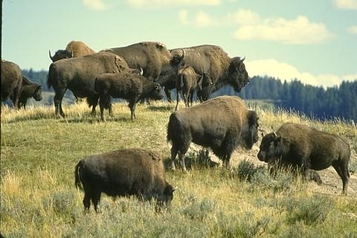
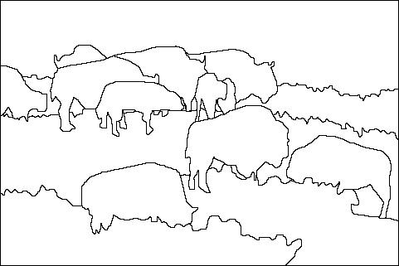
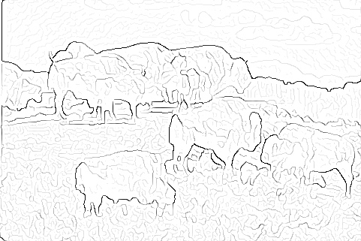
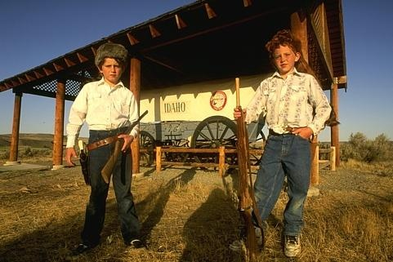
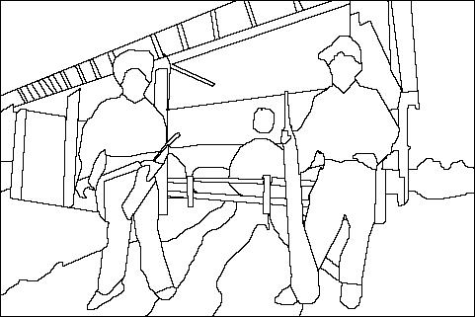
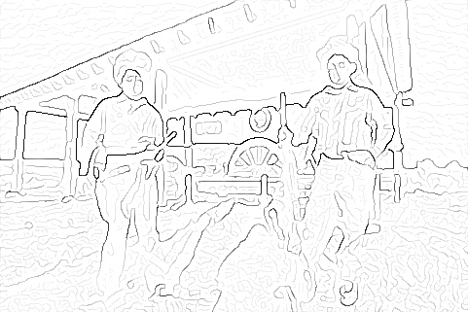
Where humans see boundaries
Berkeley segmentation database: http://www.eecs.berkeley.edu/Research/Projects/CS/vision/grouping/segbench
image
human segmentation
gradient magnitude

Slide 15


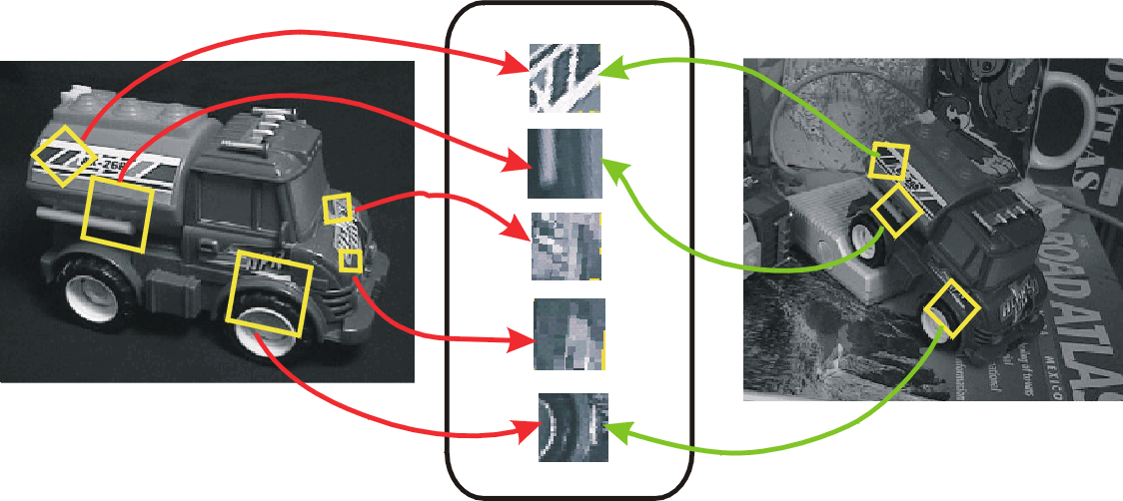
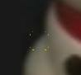
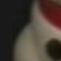
Keypoint Matching
1. Find a set of distinctive keypoints
2. Define a region around each keypoint
3. Compute a local descriptor from the normalized region
4. Match local descriptors
A₁
B₃
A₂
A₃
B₁
B₂
Features Descriptors

Slide 16
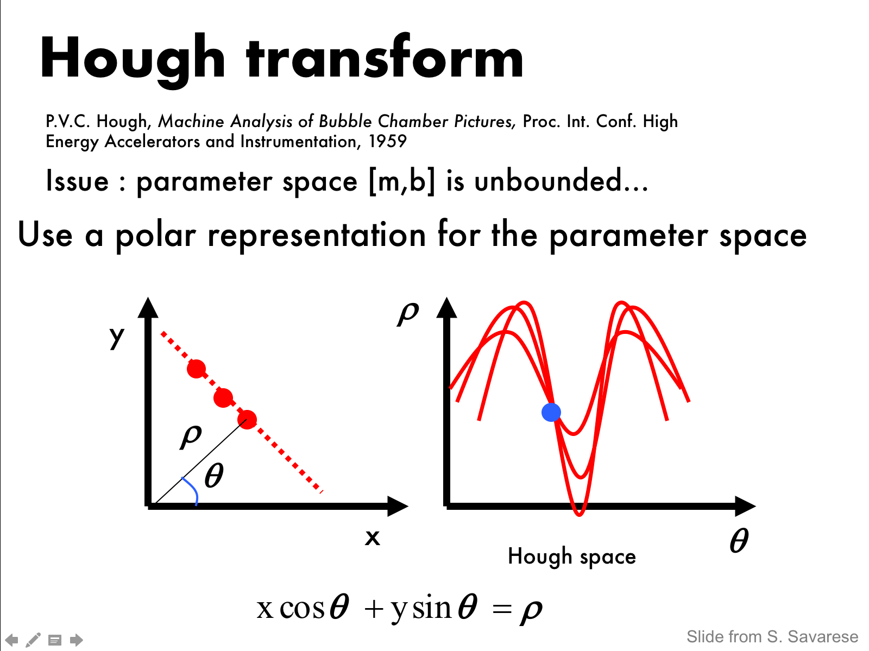
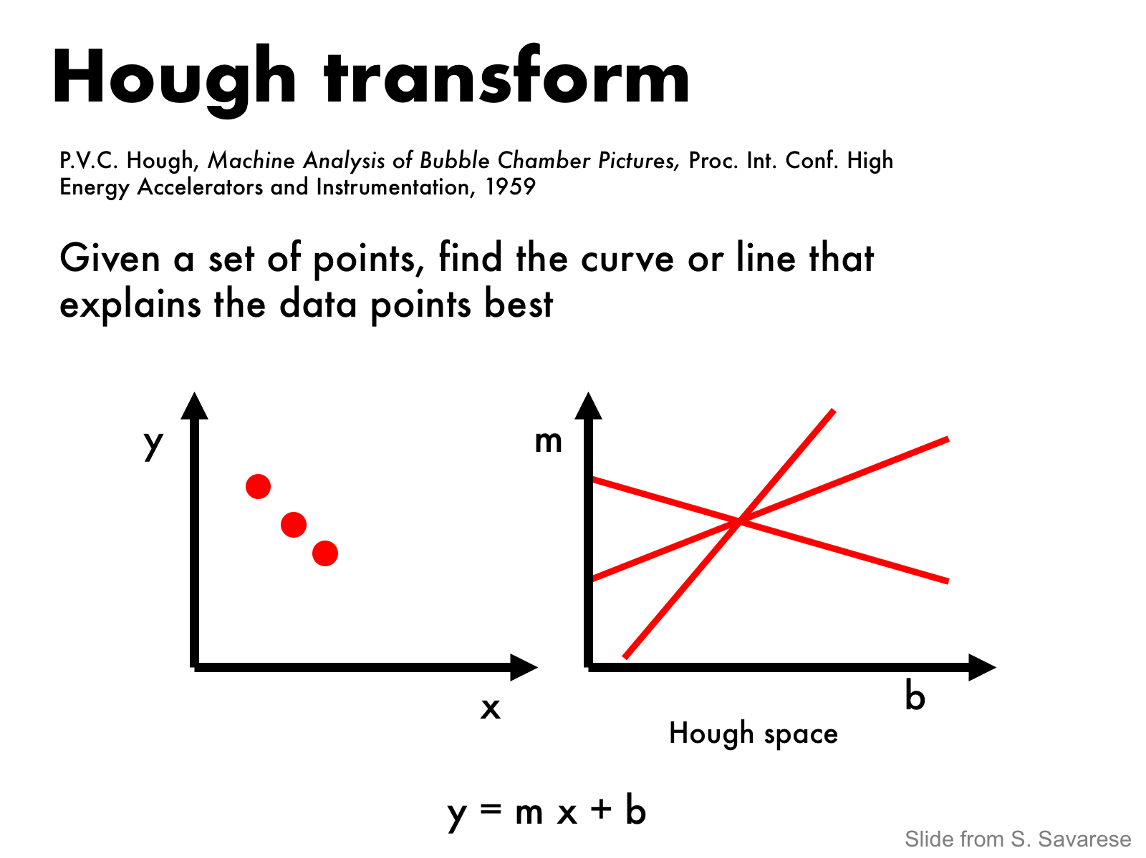
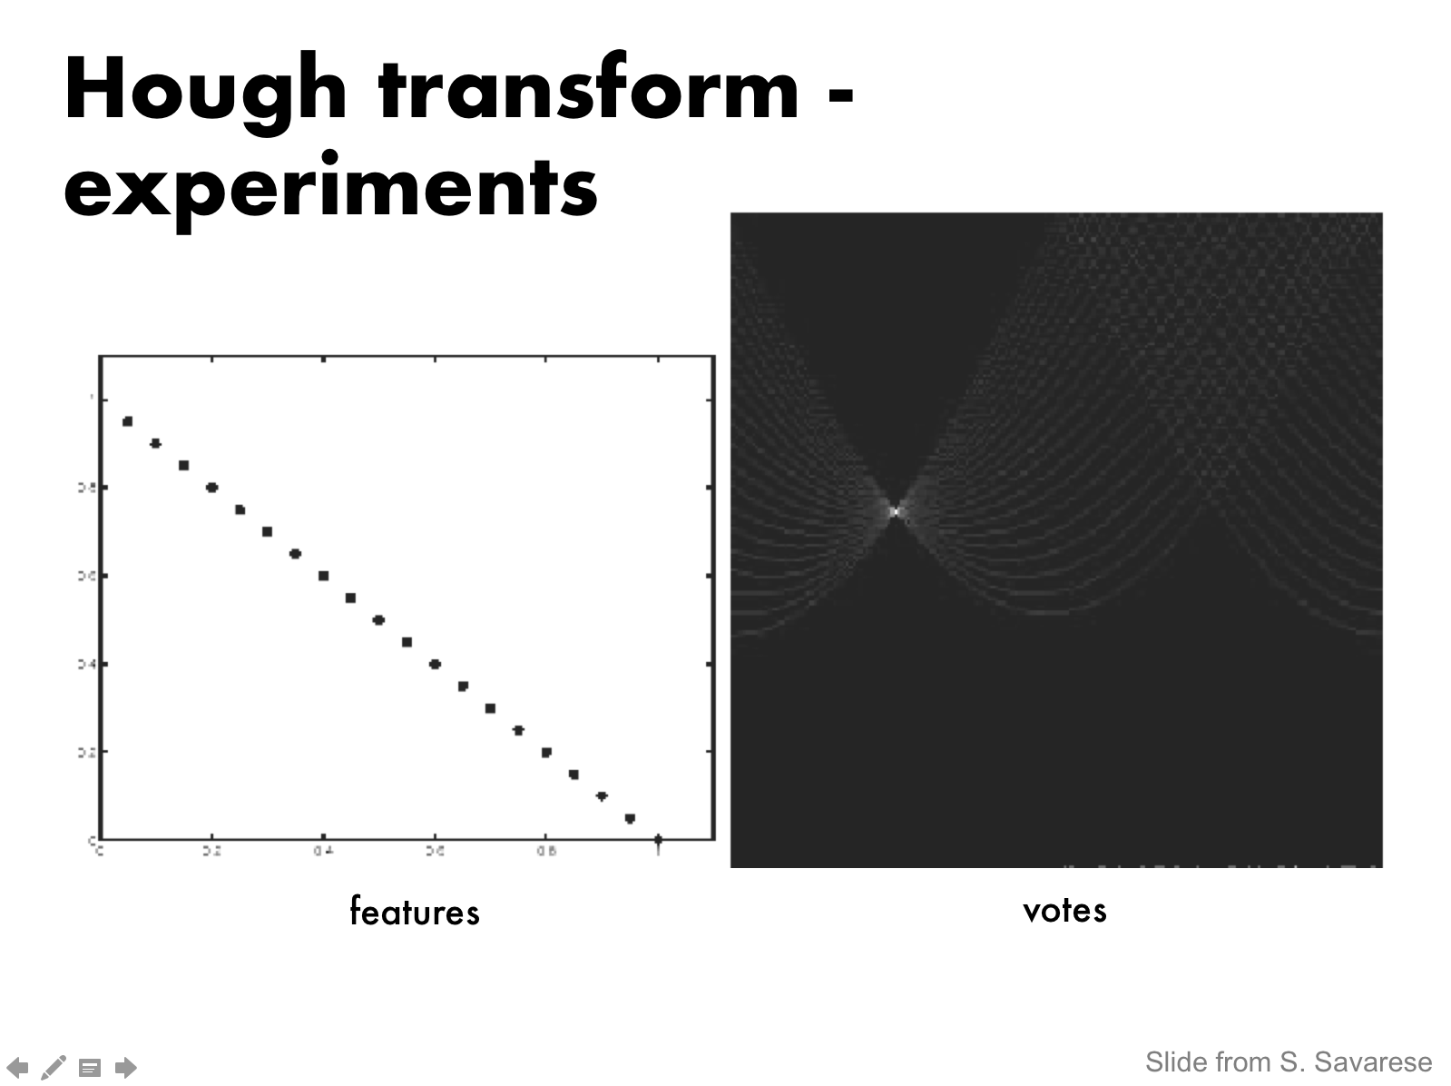


Slide 17


Slide 18





Image Categorization
Training
Training Labels
Training Images
Image Features
Classifier Training
Trained Classifier
Testing
Image Features
Trained Classifier
Prediction
Outdoor
Test Image

Slide 19




OBJECTS
ANIMALS
PLANTS
INANIMATE
NATURAL
MAN-MADE
…..
VERTEBRATE
MAMMALS
BIRDS
TAPIR
BOAR
GROUSE
CAMERA

Slide 20

Scene categorization or classification
outdoor/indoor
city/forest/factory/etc.
Svetlana Lazebnik

Slide 21
Image annotation / tagging / attributes
street
people
building
mountain
tourism
cloudy
brick
…
Svetlana Lazebnik

Slide 22
Object detection
find pedestrians
Svetlana Lazebnik

Slide 23
Image parsing / semantic segmentation
sky
mountain
building
tree
building
banner
street lamp
market
people
Svetlana Lazebnik

Slide 24
Scene understanding?
Svetlana Lazebnik

Slide 25

Recognition as an alignment problem: Block world
L. G. Roberts, Machine Perception of Three Dimensional Solids, Ph.D. thesis, MIT Department of Electrical Engineering, 1963.
1960s – early 1990s: the geometric era
J. Mundy, Object Recognition in the Geometric Era: a Retrospective, 2006

Slide 26
Example: invariant to similarity transformations computed from four points
B
C
D
A
Projective invariants (Rothwell et al., 1992):
General 3D objects do not admit monocular viewpoint invariants (Burns et al., 1993)

Slide 27






Representing and recognizing object categories
is harder...
ACRONYM (Brooks and Binford, 1981)
Binford (1971), Nevatia & Binford (1972), Marr & Nishihara (1978)

Slide 28


Recognition by components
Biederman (1987)
Primitives (geons)
Objects
http://en.wikipedia.org/wiki/Recognition_by_Components_Theory
Svetlana Lazebnik

Slide 29

General shape primitives?
Generalized cylinders
Ponce et al. (1989)
Forsyth (2000)
Zisserman et al. (1995)
Svetlana Lazebnik

Slide 30


Eigenfaces (Turk & Pentland, 1991)
1990s: appearance-based models
Svetlana Lazebnik

Slide 31
Color Histograms
1990s: appearance-based models
Swain and Ballard, Color Indexing, IJCV 1991.
Svetlana Lazebnik

Slide 32


Sliding window approaches

Slide 33






Local features for object instance recognition
D. Lowe (1999, 2004)

Slide 34

Large-scale image search
Combining local features, indexing, and spatial constraints
Image credit: K. Grauman and B. Leibe

Slide 35

Large-scale image search
Combining local features, indexing, and spatial constraints
Philbin et al. ‘07

Slide 36

Large-scale image search
Combining local features, indexing, and spatial constraints
Svetlana Lazebnik

Slide 37
History of ideas in recognition
1960s – early 1990s: the geometric era
1990s: appearance-based models
Mid-1990s: sliding window approaches
Late 1990s: local features

Slide 38


Early 2000s: parts-and-shape models
Model:
Object as a set of parts
Relative locations between parts
Appearance of part
Figure from [Fischler & Elschlager 73]

Slide 39

Discriminatively trained part-based models
P. Felzenszwalb, R. Girshick, D. McAllester, D. Ramanan, "Object Detection with Discriminatively Trained Part-Based Models," PAMI 2009

Slide 40
History of ideas in recognition
1960s – early 1990s: the geometric era
1990s: appearance-based models
Mid-1990s: sliding window approaches
Late 1990s: local features
Early 2000s: parts-and-shape models
Mid-2000s: bags of features
Svetlana Lazebnik

Slide 41
















Mid-2000s: Bag-of-features models
Texture is characterized by the repetition of basic elements or textons
For stochastic textures, it is the identity of the textons, not their spatial arrangement, that matters
Objects as textures
All of these are treated as being the same
No distinction between foreground and background: scene recognition?
Svetlana Lazebnik

Slide 42




Bag-of-features steps
Extract features
Learn “visual vocabulary”
Quantize features using visual vocabulary
Represent images by frequencies of “visual words”

Slide 43

















…
Appearance codebook
Source: B. Leibe

Slide 44
History of ideas in recognition
1960s – early 1990s: the geometric era
1990s: appearance-based models
Mid-1990s: sliding window approaches
Late 1990s: local features
Early 2000s: parts-and-shape models
Mid-2000s: bags of features
Present trends: combination of local and global methods, data-driven methods, context, deep learning
Svetlana Lazebnik

Slide 45
Alex Net https://papers.nips.cc/paper/4824-imagenet-classification-with-deep-convolutional-neural-networks.pdf

Slide 46
Deep Learning
Documents and tutorials:
https://deeplearning4j.org/documentation
https://deeplearning4j.org/convolutionalnets

